Slide 1
Battery Aging model
Neuchâtel, 15.03.2021

Slide 2
Agenda
Overview
Methodology

Slide 3

Overview

Slide 4

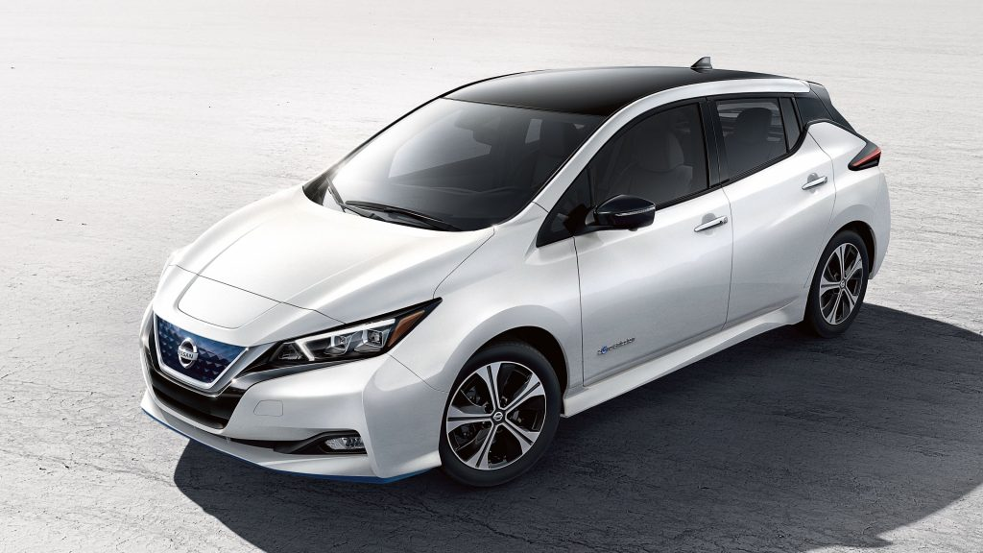
What is V2G?
Overview
Using the batteries of EVs to inject energy into the grid
First suggested in 1997 by Kempton and Letendre [1]
Other specific concepts like V2H and V2B also exist
Utilities involved in V2G projects
OVO energy (UK)
Enel (Italy)
Engie (France)
Other service (charger) providers
EVTEC (Switzerland)
Wallbox (Spain)
Nuvve (US)
Car manufacturers pressing for V2G
Nissan (Leaf, eNV-200, Ariya)
Renault (Zoe)
Mitsubishi (Outlander PHEV, i-MiEV)
[1] Kempton, Willett, and Steven E. Letendre. "Electric vehicles as a new power source for electric utilities." Transportation Research Part D: Transport and Environment 2.3 (1997): 157-175.

Slide 5





Why V2G?
Overview
To encourage EV adoption and hence accelerate the transition away from fossil fuels
How?? By showing that an EV can be a source of income
Challenge: is the extra battery degradation worth the extra income?

Slide 6




Case study
Overview
PLANAIR, Greenmotion and Renault study PV+EV integration at Y-PARC
InterReg RegEnergy project
Project report by PLANAIR showed tip smoothening (TS) and frequency containment reserve (FCR) provision as feasible options for V2G. However, in-depth techno-economic evaluation was not performed
This study performs an analysis on these V2G services to evaluate the technical and economic constraints, including the cost of battery degradation due to the provision of these services
Notes:
To do simulations and find the additional degradation due to V2G provision and to see if V2G can be profitable for a company which provides V2G chargers on their site

Slide 7

Methodology

Slide 8
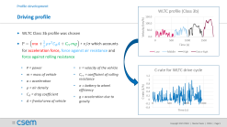
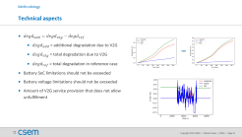
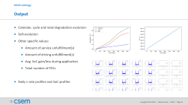
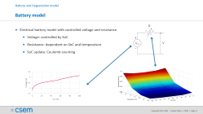
Methodology
Battery dynamics model
Battery degradation model
Technical aspects
Economic aspects
Profiles and parameters
Battery model and aging model
Battery degradation
Techno-economic analysis
Driving profiles
V2G profiles
FCR profiles
TS profiles
Output
Coding
Notes:
What I have tried to do is simulate an EV which goes to work, performs V2G service and comes back home.

Slide 9
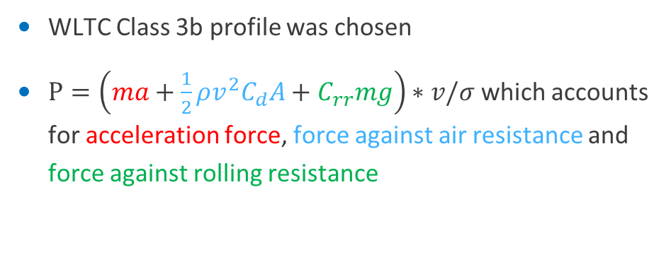
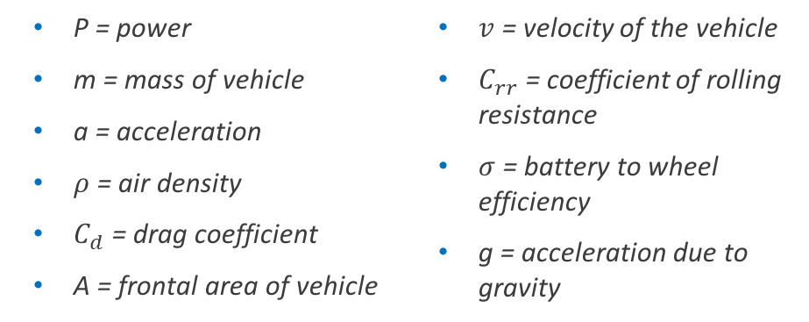
Driving profile
Profile development
WLTC Class 3b profile was chosen
$P=\left(ma+\frac{1}{2}ρv^{2}C_{d}A+C_{rr}mg\right)∗v/σ$ which accounts for acceleration force, force against air resistance and force against rolling resistance
P = power
m = mass of vehicle
a = acceleration
$ρ$ = air density
$C_{d}$ = drag coefficient
A = frontal area of vehicle
$v$ = velocity of the vehicle
$C_{rr}$ = coefficient of rolling resistance
$σ$ = battery to wheel efficiency
g = acceleration due to gravity

Slide 10

Frequency containment reserve (FCR) profile
Profile development
Ancillary service procured by TSO to keep grid frequency constant; Quantity of power delivery/withdrawal from grid based on the grid frequency
Full activation at +/- 200mHz deviation and deadband of +/-10mHz
$P=A_{\%}∗P_{C}$
P = power
A% = activation
P_{C} = contracted power/charger power
www.elia.be › elia-site › 2019-design-note-fcr-for-2020
https://ethz.ch/content/dam/ethz/special-interest/itet/institute-eeh/power-systems-dam/documents/Dissertationen/Scherer-ETH-23490.pdf
Notes:
Ancillary services are procured by TSO to keep the grid frequency constant
To compute the amount of power to be exchanged between the EV and the grid, the droop model was developed

Slide 11
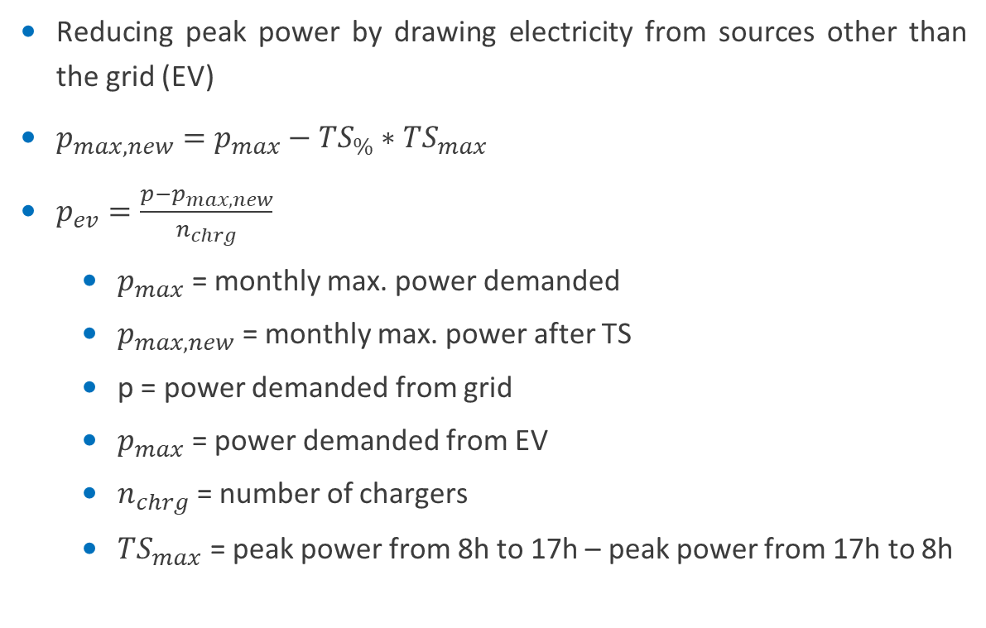
Tip smoothening/Peak shaving (TS) profile
Profile development
Reducing peak power by drawing electricity from sources other than the grid (EV)
$p_{max,new}=p_{max}−TS_{\%}∗TS_{max}$
$p_{ev}=\frac{p−p_{max,new}}{n_{chrg}}$
$p_{max}$ = monthly max. power demanded
$p_{max,new}$ = monthly max. power after TS
p = power demanded from grid
$p_{max}$ = power demanded from EV
$n_{chrg}$ = number of chargers
$TS_{max}$ = peak power from 8h to 17h – peak power from 17h to 8h
Notes:
TS is a way to save money by reducing the amount of power drawn from the grid
To do this, a limit is set on the amount of power drawn from the grid. The rest is then drawn from other sources, EV in our case. The remaining power divided by the number of EVs gives the power drawn per vehicle, which then divided by the energy capacity of the battery pack gives the C-rate.

Slide 12
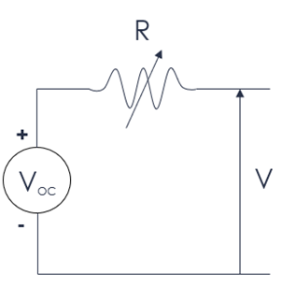
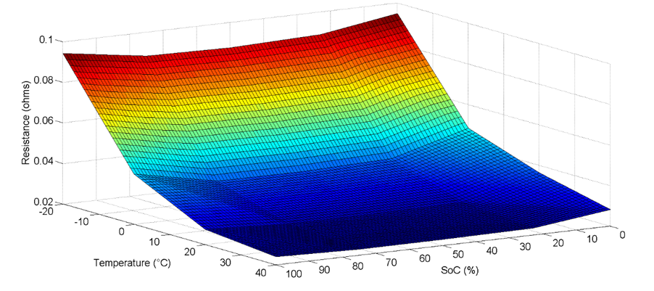
Battery model
Battery and Degradation model
Electrical battery model with controlled voltage and resistance
Voltage: controlled by SoC
Resistance: dependent on SoC and temperature
SoC update: Coulomb counting

Slide 13
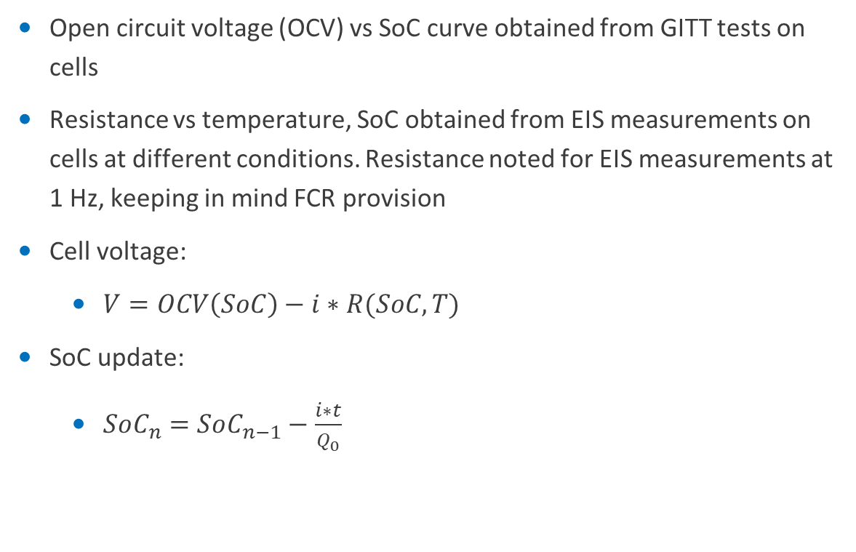
Battery model
Battery and Degradation model
Open circuit voltage (OCV) vs SoC curve obtained from GITT tests on cells
Resistance vs temperature, SoC obtained from EIS measurements on cells at different conditions. Resistance noted for EIS measurements at 1 Hz, keeping in mind FCR provision
Cell voltage:
$V=OCV\left(SoC\right)−i∗R(SoC,T)$
SoC update:
$SoC_{n}=SoC_{n−1}−\frac{i∗t}{Q_{0}}$

Slide 14

Degradation model
Battery and Degradation model
SF>1
SF = stress factor
Stress-based model; Stress factor with respect to reference case
Calculation steps:
$dr_{actual}=dr_{ref}∗SF$
$D=dr_{actual}∗t$
Stress factor calculated using experimental data from ESReC
Reference
SF=1
Degradation rate
SF<1
Time/FECs
Line | Slope | SF
20°C | 0.5 | 0.5
25°C (ref) | 1 | 1
30°C | 2 | 2
Notes:
The degradation model is basically an analytical model. It is a stress-based model where the degradation is calculated using stress factors.
First, a set of conditions are set as the reference case and the SF for these conditions is set to 1 and the degradation rate for these conditions is called the reference degradation rate. Any deviation in the operating conditions from the reference case will cause a change in the SF for that particular time span. This SF multiplied by the reference degradation rate, will give the actual degradation rate for that timespan.

Slide 15
Stress factors – Calendar aging
Battery and Degradation model
SoC
Temperature
SF parameterization.xlsx
Line | Slope | R²
SoC = 50% | 0.0113 | 0.9812
SoC = 95% (Ref) | 0.0149 | 0.984
SoC = 20% | 0.005 | 0.8947
SoC = 95% (2) | 0.0138 | 0.8681
Line | Slope | R²
5°C | 0.0014 | 0.4273
25°C | 0.0039 | 0.9411
45°C (ref) | 0.0146 | 0.986
25°C (2) | 0.0098 | 0.9851
45°C (2) | 0.0138 | 0.8681

Slide 16
Stress factors – Cycle aging
Battery and Degradation model
Avg. SoC
Temperature
DoD
C-rate

Slide 17
Stress factors – SoR model
Battery and Degradation model
Avg. SoC
DoD
C-rate

Slide 18
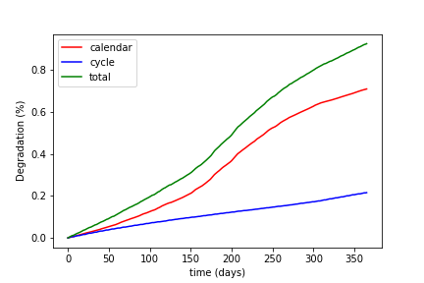
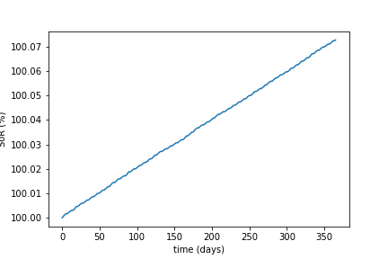
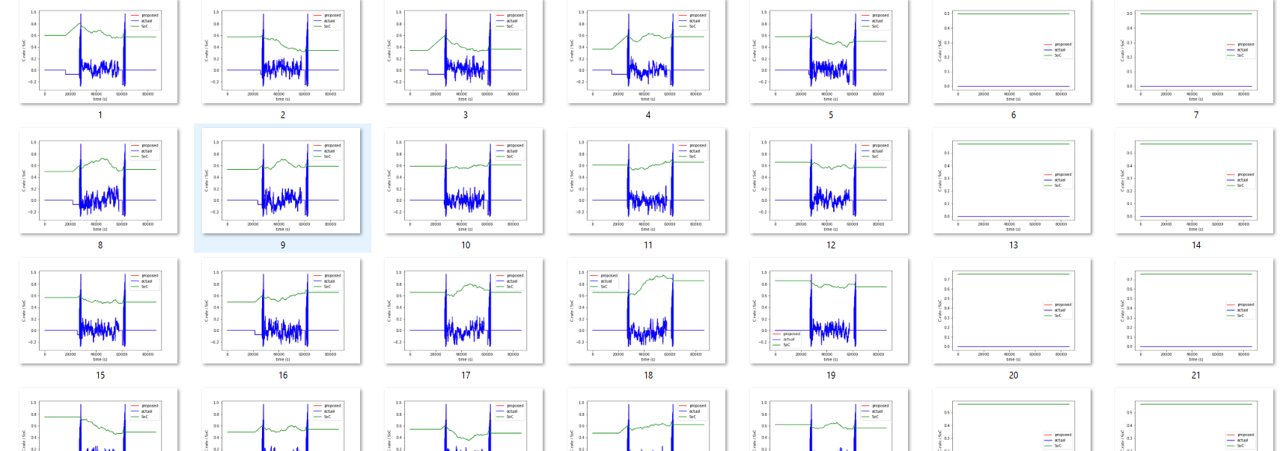
Output
Methodology
Calendar, cycle and total degradation evolution
SoR evolution
Other specific values:
Amount of service unfulfillment(s)
Amount of driving unfulfillment(s)
Avg. SoC gain/loss during application
Total number of FECs
Daily c-rate profiles and SoC profiles

Slide 19
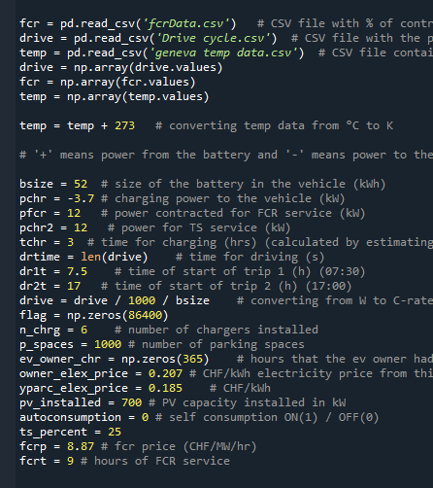
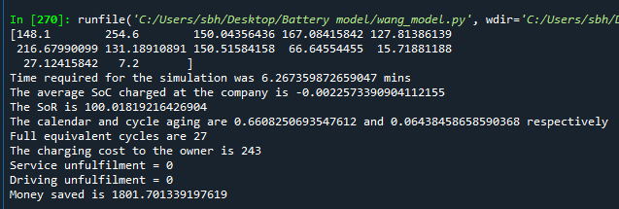
Overview
Code development
Language: Python
Takes driving, FCR and TS profiles and molds into daily c-rate profiles for simulation
Takes various inputs like:
Battery size
Charger power
PV power installed
Outputs include:
Calendar and cycle aging
Cost to the owner
Savings by company

Slide 20

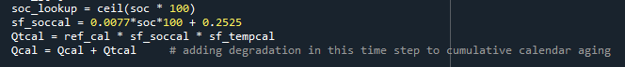
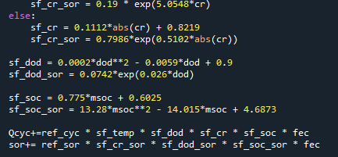
Model integration
Code development
Temperature assumed to be constant throughout the day and equal to temperature of the cell
SoC and voltage evaluation
Computed every second of the day
OCV and resistance values from lookup tables
Calendar aging
Computed every second of the day
Cycle aging and SoR evaluation
Computed at EOD
Peaks and valleys in SoC profile for the day used to extract avg. soc, c-rate and other parameters for stress model

Slide 21
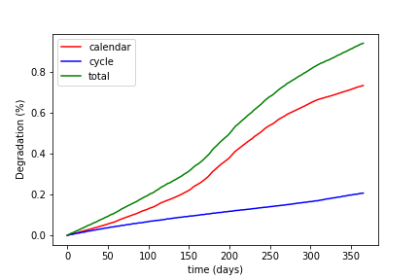
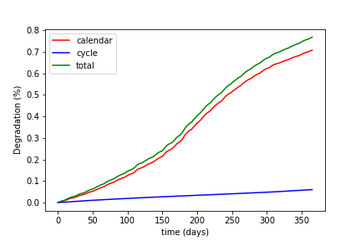
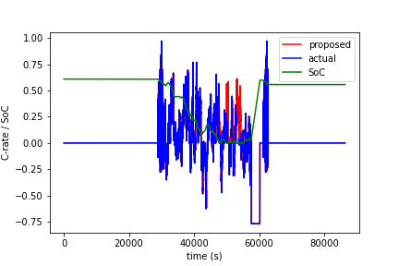
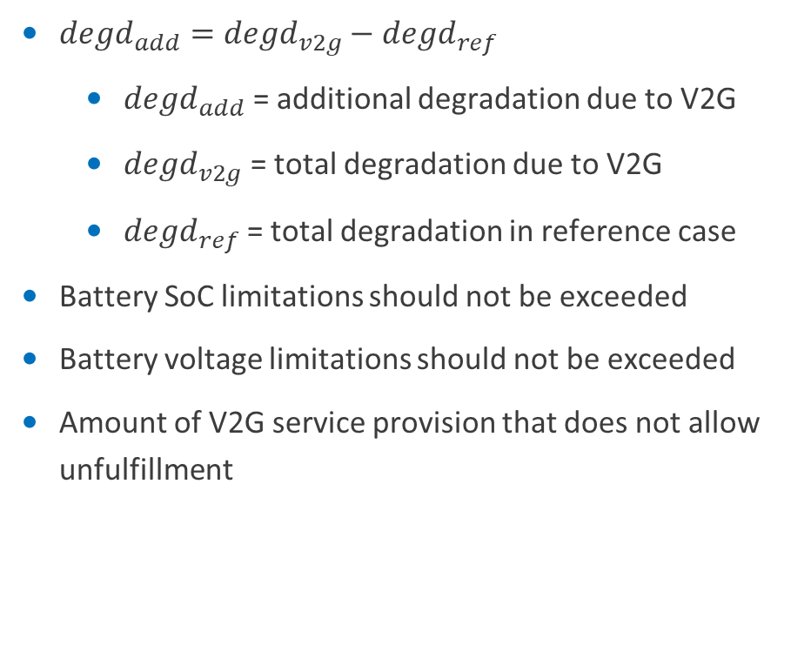
Technical aspects
Methodology
$degd_{add}=degd_{v2g}−degd_{ref}$
$degd_{add}$ = additional degradation due to V2G
$degd_{v2g}$ = total degradation due to V2G
$degd_{ref}$ = total degradation in reference case
Battery SoC limitations should not be exceeded
Battery voltage limitations should not be exceeded
Amount of V2G service provision that does not allow unfulfillment

Slide 22
Technical aspects
Methodology
Parameter | Value | Unit
EV considered | Renault Zoe (2020) | -
Kerb weight | 1563 | kgs
Battery capacity | 52 | kWh
Drag coefficient | 0.29 | -
Rolling resistance | 0.012 | -
Frontal area | 2.43 | m²
Battery-to-wheel efficiency | 0.739 | -
Braking efficiency | 0.4 | -
Parameter | Dataset
Driving profile | WLTC Class 3b
Frequency data | National Grid ESO
Company power profile | Y-Parc (PLANAIR)
Temperature | Geneva daily avg. data

Slide 23
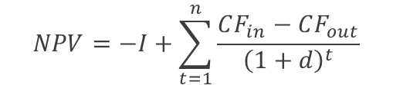

Economic aspects
Methodology
$$NPV=−I+\sum_{t=1}^{n}{\frac{CF_{in}−CF_{out}}{{\left(1+d\right)}^{t}}}$$
NPV = net present value
I = Investment
CF = Cash flow
d = discount rate
n = time period
$$Payback period=time period until NPV=0$$
Parameter | Value | Unit
Price of battery | 250 | CHF/kWh
Price of battery pack | 13000 | CHF
End of life of battery pack | 80 | %
Price of usable battery pack | 650 | CHF/%
FCR price | 8.87 | CHF/MW/hr
Peak power price (monthly) | 4.85 | CHF/kW
Electricity price @ company | 0.185 | CHF/kWh
Discount rate | 5 | %
Notes:
2 main concepts were used: NPV and payback period

Slide 24




Thank you for your attention!
Follow us on
www.csem.ch

Slide 25

Simulations and Results

Slide 26
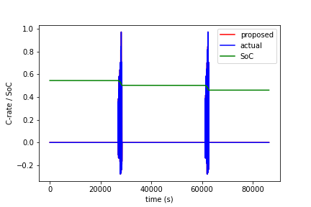
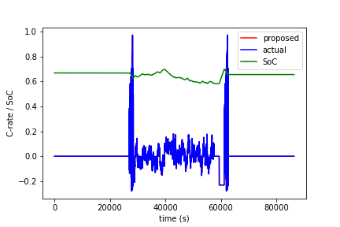
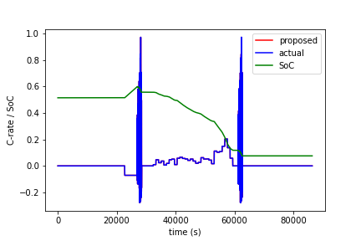
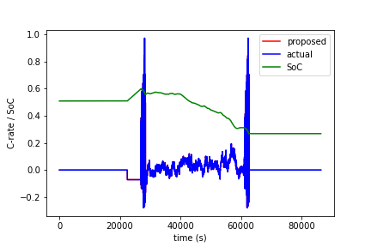
Simulated scenarios
Simulations and Results
Reference scenario: The EV is driven to work and back and is charged when SoC<20%
FCR scenario: EV provides FCR services at workplace and is charged at workplace for free as compensation
TS scenario: EV provides TS services at workplace and charges smartly at home up to 60% SoC
TS+FCR scenario: EV provides both FCR and TS services at workplace and is charged smartly at home up to 60% SoC

Slide 27
FCR scenario
Simulations and Results
FCR provision at different charger powers and amount of charging after service
Charger power of 12kW chosen since higher powers result in unfulfillment
Charging time of 30 mins chosen as durations less than 15 mins are not incentivizing for owners
Payback period of 12 years was obtained considering a charger price of CHF 300

Slide 28
TS scenario
Simulations and Results
Different amounts of TS provision with various number of chargers
Low amount of TS and high number of chargers result in lower battery degradation
However, company earnings were higher at high amounts of TS
Hence, highest amount of TS with lowest possible number of chargers was chosen for final evaluation
A payback period of 6 years was calculated for charger price of CHF 1000 with 40% of net company earnings given to EV owners

Slide 29
TS+FCR scenario
Simulations and Results
12 kW charger
6 kW for FCR
6 kW for TS
Reason for split capacities: Providing 100% FCR is required along with TS at the same time is not possible
No significant change in additional degradation between different simulated scenarios due to low power of charger
Economically, high amounts of TS and higher number of chargers provided higher net earnings
A payback period of 8 years was calculated for a charger price of CHF 1000 with 40% of the net earnings given to the EV owner

Slide 30
Comparison
Simulations and Results
Best options of each scenario are compared
Relative degradation varied from scenario to scenario
NPV after 10 years with CHF 1000 charger is CHF 13000 and CHF 9000 for the TS and TS+FCR case, respectively. NPV for the FCR case is negative.

Slide 31

Conclusion

Slide 32
Conclusions
Stress-based model for battery aging and various potential V2G services were simulated
The impact on the battery differed from service to service
Under the simulated conditions, FCR did not seem interesting. However, with increased time of FCR provision (using company cars), revenues increase, and the scenario may become interesting.
The most interesting cases have been those of TS and TS+FCR which have a payback period of 6 and 8 years respectively, with a CHF 1000 charger and 40% of the residual being paid to the owner, in addition to charging costs and battery degradation costs.

